Slide 1
Quicksort 1960 C. A. R. Hoare
Kurt Friedrich
Spring 2018
The content for a few slides and the code was originally created by Gerard Harrison.
Code Ported to C# by Mike Panitz

Slide 2
Divide and Conquer
Reduce the problem by reducing the data set.
A smaller chunck of data will easier to solve.
Ideally, subdivide the data set into two equal parts
Solve each part recursively
Very similar to MergeSort: DIFFERENCE: MergeSort sorts things ‘on the way back up’, while QuickSort puts things into semi-sorted order on the way down
So once we reach the base case(s), we’re done – we don’t need to merge stuff

Slide 3
QuickSort outline
First choose some key from the array and treat it as the pivot.
Ideally, about half the keys will come before and half after.
Then partition the items so that all those with items less than the pivot are at the front of the array, and all those with greater values are at the back of the array (but not in order).
Keeping the pivot in between the front and back segments
Then sort the two reduced lists separately recursively, and the whole list will be in order.
https://www.youtube.com/watch?v=y_G9BkAm6B8
https://www.youtube.com/watch?v=aXXWXz5rF64&feature=iv&src_vid=es2T6KY45cA&annotation_id=annotation_2485638237
https://www.youtube.com/watch?v=es2T6KY45cA
More lively: https://www.youtube.com/watch?v=ywWBy6J5gz8

Slide 4
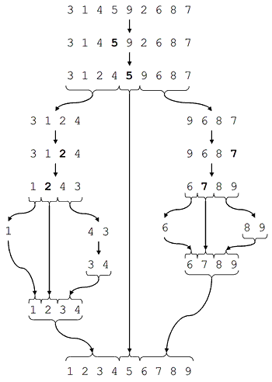
Starting array
Can be done “in place”
Pick pivot point = 5
Move other values to correct side
Not sorted, just > or < 5
Use same algo on top part
Use same algo on bot part
Recurse
Recurse
Recurse
Recurse
Return and join
Return and join
Return and join

Slide 5
Moving the elements within a segment currently being worked on
Work indexes inwards from both ends of the array.
Start from "left" and look for first element greater than pivot.
Start from "right" and look for first element less than pivot.
Swap the two items. They will now be in the correct ends of the array.
Repeat until searching indexes "meet".

Slide 6
Algorithm in public class QuickSort
User calls QSort(int[] A
QSort_private(A, leftPtr, rghtPtr)
Controls the recursive cutting segments into smaller chucks, and when to pass left or right side.
FlipInPartition(A, leftPtr, rghtPtr)
Does the work in each segment passed in. Use left element as pivot, move ptrs to find “wrong” values on each side
Swap(A, leftPtr, rghtPtr)
Swap those two values in array
While the concept is the same, there are several ways of coding QuickSort, just different ways of dealing with the pointers, and also, can be coded to be “in-place” or use more memory.
Notes:
Emphasize that we’re going to deal with a SUBSET of the array most of the time

Slide 7
Now look at code

Slide 8
Picking the pivot point
A bit of science, a bit of art, a bit of luck
Some people just take the left-most value
If you start with an array that is already close to sorted, you get very bad performance
Instead of divide and conquer and going towards
O(N * log₂(N) ), you get O(N²)
Some take the median
But some “random” distributions will suffer a similar fate
In practice, list are more often closer to being random such that you get good performance

Slide 9
This is a “nice”, random distribution.
Starting array
Pick pivot point = 5
Move other values to correct side
Not sorted, just > or < 5
Use same algo on top part
Use same algo on bot part
Recurse
Recurse
Recurse
Recurse
Return and join
Return and join
Return and join

Slide 10
Quicksort algorithm performance depends upon how random the keys are distributed.
The Quicksort algorithm is fastest when the median of the array is chosen as the pivot value. That is because the resulting partitions are of very similar size. Each partition splits itself in two and thus the base case is reached very quickly (fewest recursion levels).
In practice, the Quicksort algorithm becomes very slow when the array passed to it is already close to being sorted.
Because there is no efficient way for the computer to find the median element to use as the pivot, the first element of the array is used as the pivot.
So when the array is almost sorted, the partitions are lopsided as in next diagram.
This means that one of the recursion branches is much deeper than the other, and causes execution time to go up.

Slide 11
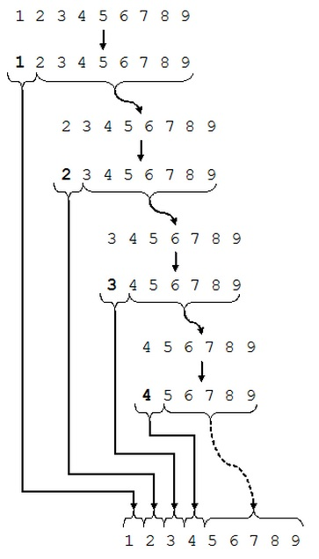
This is a “ugly”, distribution
Starting array
Pick pivot point = 1
Move other values to correct side
Pick pivot point = 2
Pick pivot point = 3
Pick pivot point = 4
And then 5, 6, 7, 8 !
Finally can do all the
returns and joins

Slide 12
Analysis: Average/Expected Case
The list is divided in half each time,
Resulting in O(log₂ n)
}
Original list
Log2(N) levels deep
N elements
N/2
N/2
N/4
N/4
N/4
N/4

Slide 13
Analysis: Average/Expected Case
So how much time at each level?
Partition will take O(N) time on each array
(N = # elements)
Partition will be run on all the sub-arrays of each level
Therefore, on each level, all the calls to partition will take a total of O(N) time
N = size of given array
}
Original list
Log2(N) levels deep
N elements
N/2
N/2
N/4
N/4
N/4
N/4

Slide 14
Analysis: Average/Expected Case
Therefore, the expected time is O(N • log₂(N) )
In the average case
What is the worst case?

Slide 15
Analysis: Worst Case
Worst possible situation: we call partition, and split off a SINGLE element, leaving N-1 to be recursively sorted
}
Original list
N levels deep
N elements
1
N-1
1
N-2

Slide 16
Analysis: Worst Case
Therefore, the expected time is O(N • N ) = O(N²)

Slide 17
Maybe a better way to pick the pivot:
The "median-of-three" pivot rule.
Do a little bit of extra work with the hopes of getting much better performance on input arrays that are nearly sorted or reverse sorted.
Choose the pivot as follows.
Consider the first, middle, and final elements of the given array.
If the array has odd length it should be clear what the "middle" element is;
For an array with even length pick the one in front of the mid point.
So for the array 3 4 5 6 7 8, the "middle" element is the second one ---- 5 and not 6!)
Identify which of these three elements is the median (i.e., the one whose value is in between the other two), and use this as your pivot

Slide 18
Look at the text version

Slide 19
are for tomatoes stomach apples than better my
into FLipInPartion, pivot value = are leftpointer = 0 right pointer = 7
apples are tomatoes stomach for than better my
apples are tomatoes stomach for than better my
into FLipInPartion, pivot value = tomatoes leftpointer = 2 right pointer = 7
apples are my stomach for than better tomatoes
apples are my stomach for than better tomatoes
into FLipInPartion, pivot value = my leftpointer = 2 right pointer = 6
apples are better for my than stomach tomatoes
apples are better for my than stomach tomatoes
into FLipInPartion, pivot value = better leftpointer = 2 right pointer = 3
apples are better for my than stomach tomatoes
apples are better for my than stomach tomatoes
into FLipInPartion, pivot value = than leftpointer = 5 right pointer = 6
apples are better for my stomach than tomatoes

